Slide 1
Newsletter
Winter 2023
USR Cares is a non-profit 501(c)(3) volunteer organization dedicated to expanding the
safety net for residents of Upper Saddle River who are in need or are experiencing a crisis.
Join us for Lunch and a
Movie at the USR Library
USR Cares invites all USR Seniors Lunch and a Movie at the USR Library. First run
movies are screened the first Thursday of each month.
Upcoming showings: Thursday, March 2nd – The Fabelmans
Thursday, April 6th – A Man Called Otto
11:30am Lunch, 1:00pm Movie
USR Cares Update
Cheer Visits with USR Seniors:
Throughout the year, we visit with roughly 100 seniors. This neighborly initiative promotes a sense of community and relationship building. During our visits we deliver good cheer, cards, plants, crafts, cookies, activity booklets and other items to our wonderful seniors.
A few of the local USR Library offerings www.uppersaddleriverlibrary.org
Move It Mondays 9:00am Walks at Lions Park Social Bridge Fridays at 10:00am Mornings Book Groups Adult Programs Library Speakers | Classes-over 600 online courses Movie Afternoons – First Thursday of every month Author Talks Chat & Stitch Drop In Wednesdays at 12:00pm
Free County Transportation!
FREE for anyone the age of 60 who lives in Bergen County.
Request transportation at least 2 weeks ahead of time.
Transportation needs to be within Bergen County between 10:30am – 2:00pm
Contact (201) 368-5955
CBD WORKSHOP, Monday, March 6th at 7pm
CBD has become a major offering in the health and wellness industry. Information on how it is made, what benefits and best to use it based on individual’s needs. Registration required.
“NEW” MINDFUL BREATH AND MOVEMENT
Wednesdays 10-10:30am, 3/1, 3/8, 3/15, 3/22, 3/29
One Body Yoga will guide you through accessible, mindful breath and movement practice. No experience needed.
Try this Word Scramble:
L O S A C O H T E C
100 Years Ago
in 1923…
The first home game was played at Yankee Stadium against the Boston Red Sox with NY winning 4-1.
For information about USR Cares or to donate,
visit our website at USRCares.com or email at
usrcares@gmail.com.
Please send us your email so we can stay connected!

Slide 2
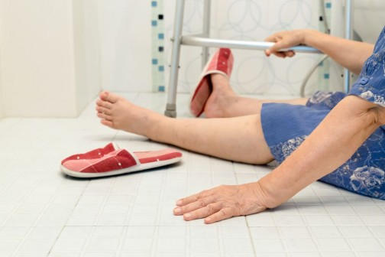
Page 2
Newsletter
Senior Safety!
Steps to Prevent a Fall
Talk to your healthcare provider, discuss risks and medication side effects.
Keep moving: Walking and chair exercises including yoga and dance moves help improve balance, strength, and flexibility.
Wear properly fitting shoes: non-skid footwear and socks.
Remove home hazards: electrical and phone cords, papers, loose area rug. Also, use non-slip bath mats.
Light up your living space: use nightlights in walkways and bathrooms, turn up lights before you use the stairs.
Use assistive devices such as a cane or walker for added balance.
Upper Saddle River is truly a community of caring where neighbors look out for one another.
Our community organizatons are the backbone of our town offering opportunities to become involved in groups that interest you and to offer outreach.
USR Cares was formed to offer support to families in crisis as well as have a strong focus on our senior community. We welcome you to call on us if we can be of assistance.
Website: USRCares.com
Email: usrcares@gmail.com
Health & Wellness
FREE Radon Testing
Radon is a naturally-occurring radioactive gas found in soil that can increase the risk of lung cancer.
Contact: Bergen County Department of Health Services, 220 East Ridgewood Ave., Paramus. Telephone: (201) 634-2804
Seniors are invited to a Saint Patrick’s Day Party
held by 2 Junior USR Girl Scout troops, enjoy Snacks - Crafts - Games
Friday, February 17th at the USR Library from 3:15pm to 4:45pm
Helpful Tips for Seniors…Chore is a service for 60+ seniors and disabled populations in Bergen County.
Volunteers help make your home a safer place to live! Minor home repairs such as plumbing,, electrical, weatherization. Call Chore for help at (201) 489-7790
USR Cares Newsletter Winter 2023, page 2
Answer: CHOCOLATES

